Slide 1
UNIVERSITY Database
Let us take an example of UNIVERSITY database and formulate SQL queries to solve few questions related to the UNIVERSITY database.
We shall try to use most of the concepts covered in this course to write SQL queries and analyze the results.
But first, let us try to understand the UNIVERSITY schema –
Student(Sid, Sname,GPA)
MajorsIn(Sid,Major)
Book(BookNo, Title, Price)
Cites(BookNo,CitedBookNo)
Buys(Sid,BookNo)

Slide 2
The relation MajorsIn stores students and their majors.
A student can have multiple majors, but we also allow that a student can have no major.
A record (b,c) in the relation Cites indicates that the book with book number b cites the book with book number c.
Note that a book may cite multiple other books and also, a book does not have to cited.
The keys of the relations are the underlined attributes.
Let us take a look at the text files that contain the data to be stored in the respective tables.

Slide 3
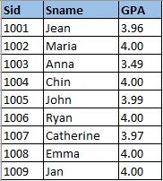
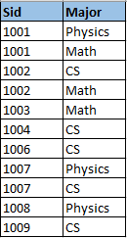
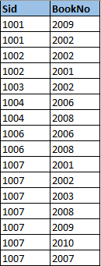
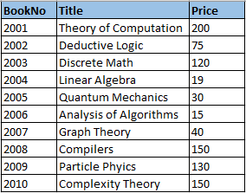
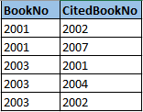
Student MajorsIN Buys
Book
Cites

Slide 4
Now let us create a database with the name UNIVERSITY and create tables in UNIVERSITY according to the above defined schema.
While creating the tables, we need to define data types for the various attributes as well as primary and foreign key constraints. Where appropriate, let us add “ON DELETE CASCADE” statements with the foreign key constraints.
And then let us use MySQL’s LOAD statement to load data from the five .txt files.
QUERY RESULTS

Slide 5



QUERY RESULTS

Slide 6
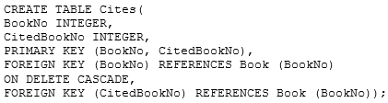

QUERY RESULTS

Slide 7

QUERY RESULTS
Once all the files are loaded into the database, we can do a “SELECT * FROM table_name” to validate the data.
Now, let us answer a few queries about the UNIVERSITY database using SQL and try to analyze the results.

Slide 8

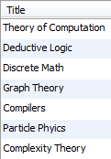
Find the titles of books that cost more that $30.
QUERY RESULT
Note that while creating alias of a table, we can actually ignore the “AS” keyword. Alias will be created with or without “AS” keyword.
2) Find Sid’s and Sname’s of students who major in “CS” and who buy a book that costs less that $20

Slide 9


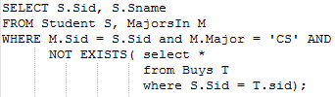

QUERY RESULT
Find Sid’s and Sname’s of students who major in ”CS” but do not buy any book.
The inner query returns the details of all the students who buy books and the NOT EXISTS operator negates the result, providing us details of the students who do not buy any book.

Slide 10
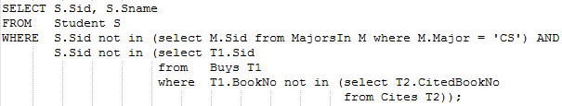

Find Sid’s and Sname’s of students who neither major in “CS” nor buy any book that is not cited.
QUERY RESULT
The NOT IN part filters out the records with not major in CS and books that are not cited.
Find the BookNo’s of books that are cited by at most two books.

Slide 11
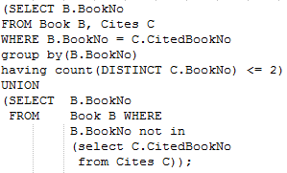

QUERY RESULT
If you look at the question carefully, it asks for books that are cited by at most 2 books, which means books cited by 0,1 or 2 books.
The first query returns all the books cited by <= 2 books and the second query returns details of such books which are not cited by any.

Slide 12




Find the BookNo’s of books that cite books that cost less than $20.
QUERY RESULT
Find the Sid’s of students that have exactly two majors and buy at least one book.
QUERY RESULT

Slide 13
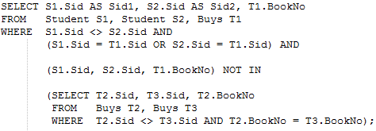
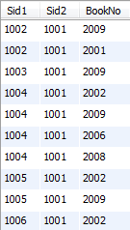
The count operator takes care of exact 2 majors whereas a simple join between “Student” and “Buys” tables ensures that a student buys at least one book.
Find the records in the form (s1,s2,b) where s1 and s2 are different Sid’s and b is the BookNo of a book that is either bought by s1 or by s2 (So the books are not bought by both s1 and s2).
QUERY RESULT

Slide 14
The result actually contains 208 records but I couldn’t output all the records, hence only first 10 rows are displayed.
The question asks for the result in the format <Student1, Student2, BookNo> where the book is bought by either Student1 or Student2 but not both. In scenarios like this, self join plays an important role.
We need the details from the same table where one record is not equal to another. Hence the line S1.sid <> S2.sid in the first query ensures that S1 and S2 are different in each resultant record.
The second query with NOT IN operator contains details in the form <S1, S2, B> where a book is bought by both S1 and S2. For example, book 2002 is bought by both student 1001 and 1002. We don’t need records like this and hence the NOT IN negates these results from the output.

Slide 15


Find the records in the form (s1,s2) where s1 and s2 are different Sid’s and such that s1 and s2 buy exactly one book in common.
QUERY RESULT
Here again the self join ensures that different Sid’s are considered and the count operator filters students who buy only one book in common.

Slide 16
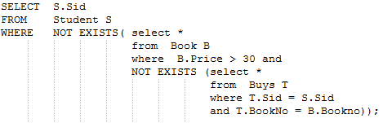

Find the Sid’s of students who buy all books that cost more than $30.
QUERY RESULT
The sub query (after the first NOT EXISTS) returns details of such students who have not purchased some books that cost more than $30. They might have purchased books that cost more than $30 but not all of them.
Hence the first NOT EXISTS operator negates such students from the result.

Slide 17
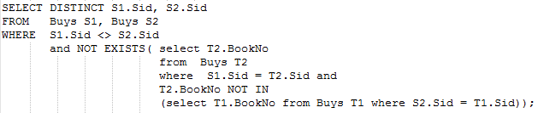

Find the records in the form (s1,s2) where s1 and s2 are different Sid’s and such that student s2 buys all the books student s1 buys.
QUERY RESULT
The sub query returns such books which are bought by S1 but not by S2. Inside the sub query, the first join with T2 and S1 gives us the books bought by S1 and the NOT IN operator filters the students(S2) who did not buy the same book.

Slide 18


For example, the sub query yields Book 2001 which is bought by 1002(S1) but not 1001(S2).
Now the initial NOT EXISTS operator removes the above results, which essentially gives us the results where S2 buys all the books which are bought by S1.
Find the BookNo’s of books with the lowest price.
QUERY RESULT
This query should be fairly straightforward to understand.

Slide 19
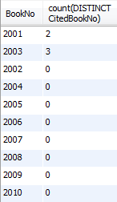
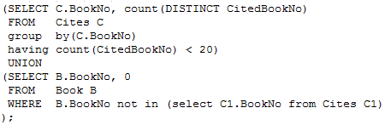
For each book specify the number of books they cite, provided that this number is less than 20.
QUERY RESULT
The first query essentially gives us the result but this does not cover the books that do not cite any other books. Hence the second query, with 0 appended in the count column combines the above result set with rest of the books that do not cite any other books.

Slide 20
General guidelines
This is not like a class project but just an example dataset which allows you to get comfortable with writing SQL queries.
Please execute all the queries on MySQL DB and validate the result with the dataset.
Wherever sub queries are involved, break down the query and try to execute the inner most query first and see the results obtained. Then compare with the main query results. This will help to better understand the solution.
There can be more than 1 solution to the given problem so try to come up with your own query and compare the results with the provided solution.

